Slide 1


Roth peranson algorithm SEMINAR presentation
MOJAMMIL
157238
COMPUTER SCIENCE ENGINEERING DEPARTMENT
NIT WARANGAL

Slide 2
Topics to be covered
Introduction to the Algorithm
Working of the Algorithm
Working demo
It’s application in day to day life
It’s importance in the medical field

Slide 3
Introduction
The Algorithm was proposed by Lloyd Shapley and David Gale in 1962.
Initially the algorithm aims to solve the stable marriage problem but later on find its application in different areas.
The algorithm runs on different data sets and based on the preference given by the user produces the stable pairing.
A set of pairing is called stable if there is no pair that prefers each other to their assigned matches.

Slide 4
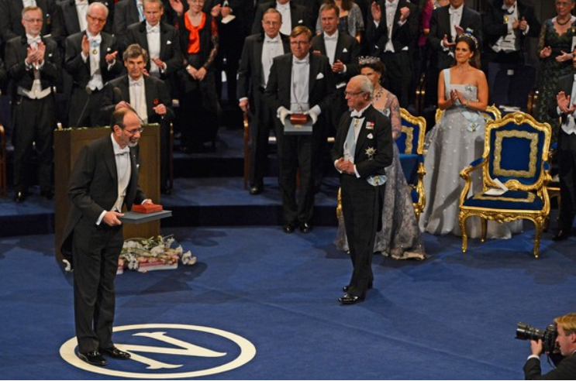
Alvin Roth and others did further work on matching problem, leading to Shapley and Roth receiving a Nobel Prize in 2012.
They considered location also as one of the factor for matching criteria.
Alvin Roth accepting the Nobel Prize in 2012.

Slide 5
Stable Marriage Problem
The Problem of trying to find the stable pairings between two sets of people(i.e., men and women who want to get married).
A set of pairings is considered stable if there is no pair that prefers each other to their assigned matches.

Slide 6
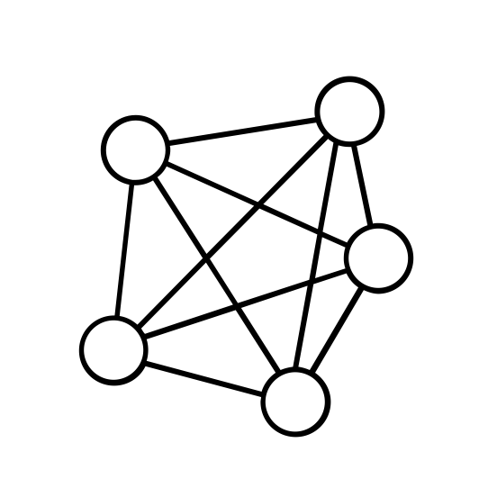
Algorithm Working

Slide 7








Sunny
Arthur
Joseph
Latha
Dan
Org2
Org2
Org1
Org2
Org3
Org1
Org1
Org2
Org3
Org2
Org1
Org3
Org1(2 Positions )
Org2(2 Positions)
Org3(2 Positions)
Dan
Joseph
Dan
Sunny
Arthur
Latha
Joseph
Dan
Sunny
Joseph
Latha

Slide 8
No Matched
Matched
Arthur
Dan
Sunny
Joseph
Latha
Org1(2 Positions )
Org2(2 Positions)
Org3(2 Positions)

Slide 9
Demo

Slide 10
Application
It is used in National Resident Matching Program in US
Most of the online dating sites uses this algorithm to optimize user experience
At college level, it can be used to select the Project and Project guide.
This algorithm can be used to develop an Application which can be helpful for both job seeker as well as job provider

Slide 11
Application in Medical Field
Kidney exchange program

Slide 12
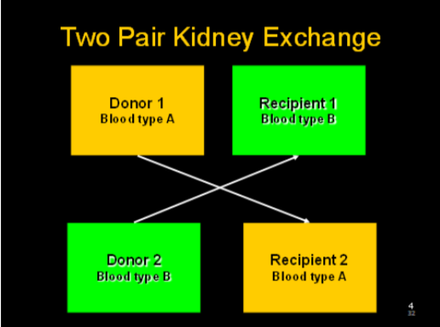
A 2-way exchange involves 4 simultaneous surgeries.

Slide 13
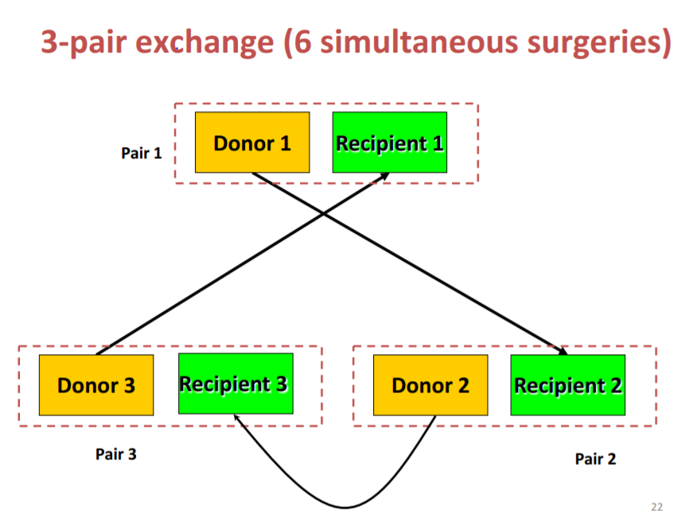

Slide 15
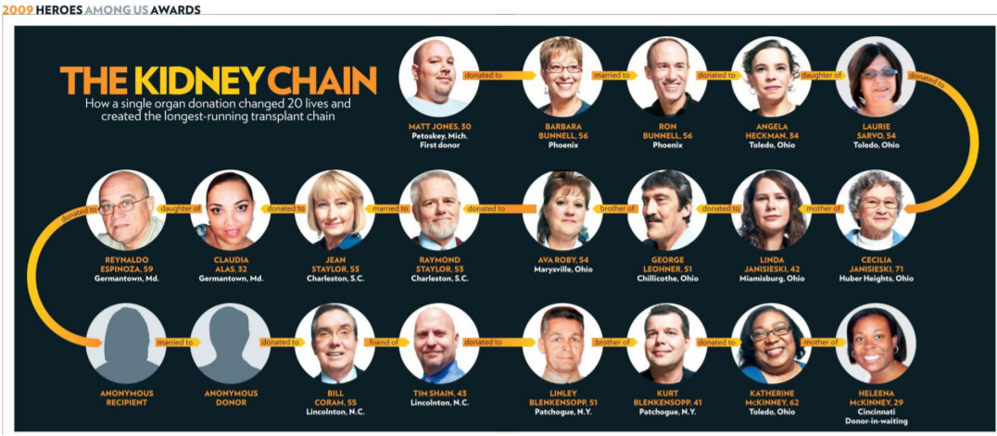
Longest Running Transplant Chain

Slide 16
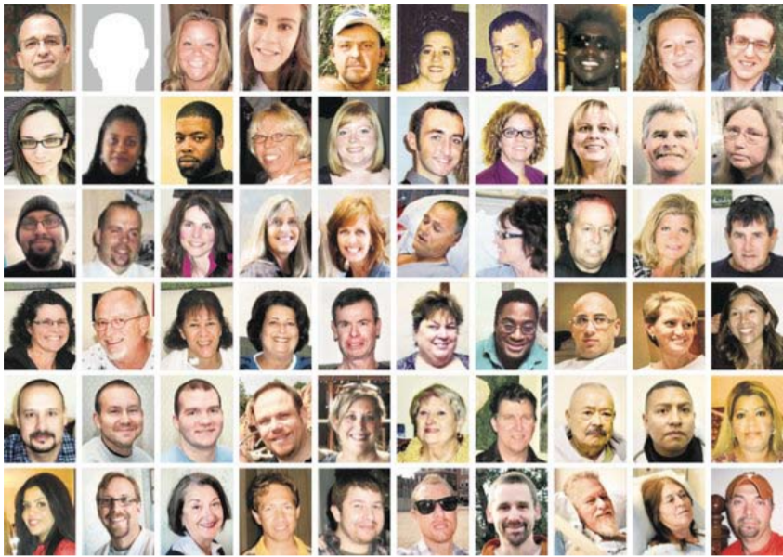
People who got organ transplant using National Residency Match Program(2012)

Slide 17
ThankYou

Slide 18
Sunny
Arthur
Joseph
Latha
Dan
Org2
Org2
Org1
Org2
Org1
Org1
Org1
Org2
Org3
Org2
Org1
Org3
Org1(2 Positions )
Org2(2 Positions)
Org3(2 Positions)
Dan
Joseph
Dan
Arthur
Sunny
Latha
Joseph
Dan
Arthur
Joseph
Latha

